Slide 1
A core Course on Modeling
Introduction to Modeling
0LAB0 0LBB0 0LCB0 0LDB0
c.w.a.m.v.overveld@tue.nl
v.a.j.borghuis@tue.nl
S.12

Slide 2
Definition phase: what purpose?
define
formulate
purpose
conceptualize
identify
entities
choose
relations
formalize
obtain
values
formalize
relations
execute
operate
model
obtain
result
conclude
present
result
interpret
result
Notes:
2

Slide 3
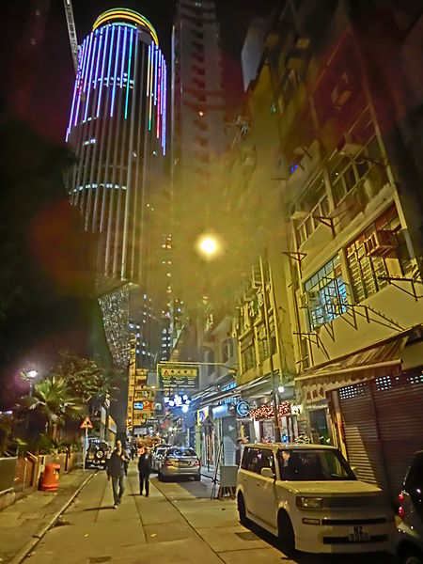
‘how to optimize road illumination’
http://commons.wikimedia.org/wiki/File:HK_Wan_Chai_%E5%BB%88%E9%96%80%E8%A1%97_Amoy_Street_night_view_Hopewell_Apr-2013.JPG
Notes:
3
Have students come up with suggestions:
seek a sharp formulation, use the list of purposes (see previous week):
Examples:
verify:could LED lamps do the job?
decide:yes or no adaptive illumination?
optimize:what is the best height (or distance or power or …) for lanterns?
analyse:how do benefits of adaptive illumination depend on the traffic flow?
control:for real time managing adaptive switch on/off strategy
(perhaps more …?)

Slide 4
http://commons.wikimedia.org/wiki/File:HK_Wan_Chai_%E5%BB%88%E9%96%80%E8%A1%97_Amoy_Street_night_view_Hopewell_Apr-2013.JPG
Conceptualization phase: what entities?
define
formulate
purpose
conceptualize
identify
entities
choose
relations
formalize
obtain
values
formalize
relations
execute
operate
model
obtain
result
conclude
present
result
interpret
result
Notes:
4

Slide 5
http://commons.wikimedia.org/wiki/File:HK_Wan_Chai_%E5%BB%88%E9%96%80%E8%A1%97_Amoy_Street_night_view_Hopewell_Apr-2013.JPG
lantern
road
moon
car
trees
driver
traffic
Notes:
5
skip moon: problem should also be solved for moonless nights
skip trees: complicating factor, first assume no trees
add driver: otherwise illumination would be superfluous
add traffic: ‘ adaptive’ means: w.r.t. traffic density
First inventory of concepts:
enough concepts to formulate problem
few as possible: estimate which concepts are crucial, which not
discover first set of assumptions (such as: assume no tree shadows and no moonlight)

Slide 6
Conceptualization phase: what properties?
define
formulate
purpose
identify
entities
has-a,
part-of
conceptualize
choose
relations
formalize
obtain
values
formalize
relations
execute
operate
model
obtain
result
conclude
present
result
interpret
result
Notes:
6

Slide 7
lantern
height
power
road
width
reflectivity
car
seat height
speed
driver
visual capabilities
traffic
density
Notes:
7
For every concept:
what info do we need for that concept?
distinguish important and less important properties; start with only important ones (important w.r.t. purpose)
‘ seat height’ is ignored, because difference in viewing angle probably small

Slide 8
lantern
height
power
road
width
reflectivity
car
seat height
speed
driver
visual capabilities
traffic
density
authority
expenses
Notes:
8
expenses is added as a property of something that wasn’t there yet. Therefore: add
Sometimes we realize there must be an additional property to merit the effort of the model

Slide 9
Conceptualization phase: what relations?
define
formulate
purpose
conceptualize
identify
entities
choose
relations
other than has-a, part-of
formalize
obtain
values
formalize
relations
execute
operate
model
obtain
result
conclude
present
result
interpret
result
Notes:
9

Slide 10
authority
driver
1
expenses
visual capabilities
lantern
height
power
car
speed
height
road
width
surface reflectance
traffic
density
Notes:
10

Slide 11
authority
driver
illuminate(lantern^{n}, road¹)
1
expenses
visual capabilities
lantern
height
power
n
car
speed
height
illuminate
1
road
width
surface reflectance
traffic
density
Notes:
11
relation involves multiple lanterns (hence n) and only one road (hence 1; may skip the ‘1’, like in a¹b²=ab²)
helps to realise that, at any point of the road, the light of multiple lanterns contributes.
‘located on’ is another relation between lanterns and road: helps to think about distance between lanterns

Slide 12
authority
driver
illuminate(lantern^{n}, road¹)
operatedBy(car, driver)
1
expenses
visual capabilities
1
lantern
operated by
height
power
1
n
car
speed
height
illuminate
1
road
width
surface reflectance
traffic
density
Notes:
12
helps to realize that the location of the viewer (=driver) and the location of the car (=the trigger for the adaptivity) are the same

Slide 13
authority
driver
illuminate(lantern^{n}, road¹)
operatedBy(car, driver)
consistsOf(traffic, car^{n})
1
expenses
visual capabilities
1
lantern
operated by
height
power
1
n
car
speed
height
illuminate
n
1
consists of
road
1
width
surface reflectance
traffic
density
Notes:
13
helps to realize that properties (e.g., density) of ‘traffic’ can be found by aggregating (averaging) properties (e.g., speed) of multiple cars

Slide 14
authority
driver
illuminate(lantern^{n}, road¹)
operatedBy(car, driver)
consistsOf(traffic, car^{n})
ridesOn(traffic, road)
1
expenses
visual capabilities
1
lantern
operated by
height
power
1
n
car
speed
height
illuminate
n
1
consists of
road
1
width
surface reflectance
1
traffic
1
rides on
density
Notes:
14
helps to realize that we can make assumptions on the possible location of cars, facilitating the adaptivity and the places where we should assess road visibility

Slide 15
authority
driver
illuminate(lantern^{n}, road¹)
operatedBy(car, driver)
consistsOf(traffic, car^{n})
ridesOn(traffic, road)
sees(driver,lantern^{n}, road)
1
1
expenses
visual capabilities
1
lantern
operated by
height
power
n
1
n
sees
car
speed
height
illuminate
n
1
consists of
road
1
1
width
surface reflectance
1
traffic
1
rides on
density
Notes:
15
3-fold relation, tells us that geometric reasoning is needed to calculate visibility and/or blinding thresholds

Slide 16
authority
driver
illuminate(lantern^{n}, road¹)
operatedBy(car, driver)
consistsOf(traffic, car^{n})
ridesOn(traffic, road)
sees(driver,lantern^{n}, road)
pays(authority, lantern^{n})
1
1
expenses
visual capabilities
1
pays
1
lantern
operated by
height
power
n
n
1
n
sees
car
speed
height
illuminate
n
1
consists of
road
1
1
width
surface reflectance
1
traffic
1
rides on
density
Notes:
16
helps to investigate (a) what else needs to be paid for, and (b) what else might be a concern for authorities

Slide 17
adjacent
authority
driver
illuminate(lantern^{n}, road¹)
operatedBy(car, driver)
consistsOf(traffic, car^{n})
ridesOn(traffic, road)
sees(driver,lantern^{n}, road)
pays(authority, lantern^{n})
adjacent(lantern, lantern²)
1
1
expenses
visual capabilities
1
2
pays
1
lantern
operated by
1
height
power
n
n
1
n
sees
car
speed
height
illuminate
n
1
consists of
road
1
1
width
surface reflectance
1
traffic
1
rides on
density
Notes:
17
helps thinking about adaptivity control: lantern communicates to neighbor about presence of car
This rises the issues of
inifinity of the road
are there or are there no lanterns on the other side of the road

Slide 18
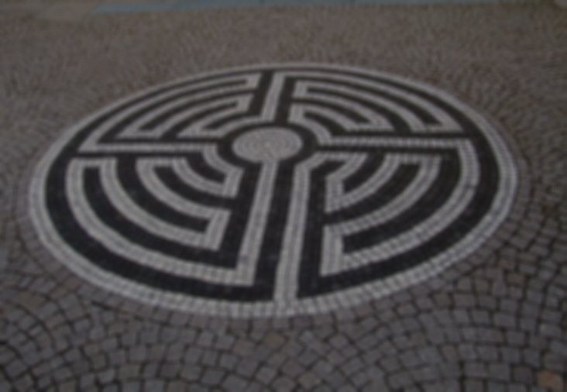
QUIZ
Why are the arities of the ‘adjacent’ relation 1 and 2, respectively?
When is this true for all lanterns?
adjacent
authority
driver
illuminate(lantern^{n}, road¹)
operatedBy(car, driver)
consistsOf(traffic, car^{n})
ridesOn(traffic, road)
sees(driver,lantern^{n}, road)
pays(authority, lantern^{n})
adjacent(lantern, lantern²)
1
1
expenses
visual capabilities
1
2
pays
1
lantern
operated by
1
height
power
n
n
1
n
sees
car
speed
height
illuminate
n
1
consists of
road
1
1
width
surface reflectance
1
traffic
1
rides on
density
Notes:
18
helps thinking about adaptivity control: lantern communicates to neighbor about presence of car
This rises the issues of
inifinity of the road
are there or are there no lanterns on the other side of the road

Slide 19
adjacent
authority
driver
illuminate(lantern^{n}, road¹)
operatedBy(car, driver)
consistsOf(traffic, car^{n})
ridesOn(traffic, road)
sees(driver,lantern^{n}, road)
pays(authority, lantern^{n})
adjacent(lantern, lantern²)
locatedOn(lantern^{n},road)
1
1
expenses
visual capabilities
1
2
pays
1
lantern
operated by
1
height
power
n
n
1
n
sees
car
speed
height
located on
illuminate
n
1
1
consists of
road
1
1
width
surface reflectance
1
traffic
1
rides on
density
Notes:
19
Given the full list of concepts, it is recommended to check (all?) possible relations to find which might be essential for the model
It usually requires several iterations before the lists of concepts, properties, values and relations are appropriate.
At any time, check against the purpose of the eventual model
Relations in the CM are in natural language, not yet in the form of mathematics, logic or computer ‘language’.
Next two weeks: how to find suitable mathematical expressions (typically: functions) to go from conceptual model to formal model.
For all but trivial models, a purely textual list of concepts, properties and values is inapproporiate.
Use complementary (schematic) drawing.
Use ‘standard’ notation, such as Entity Relationships or UML-light.

Slide 20
adjacent
authority
driver
1
1
expenses
visual capabilities
1
2
pays
1
lantern
operated by
1
height
power
n
n
1
n
sees
car
speed
height
located on
illuminate
n
1
1
consists of
road
1
1
width
surface reflectance
1
traffic
1
rides on
density
Notes:
20
This CM representation is called: ‘Entity-Relationship Graph’
All occurring entities are concepts
Concepts are boxes
Concept-info in the form of properties
Relations are diamonds
Numbers indicate ‘arity’ of relations
A conceptual model is a collection of concepts (with properties and values) and the relations connecting them, related to the model’s purpose
Intermediate communication purpose: ‘is this the situation that you have in mind'

Slide 21
Formalization phase: what value sets?
define
formulate
purpose
conceptualize
identify
entities
choose
relations
formalize
obtain
values
formalize
relations
execute
operate
model
obtain
result
conclude
present
result
interpret
result
Notes:
21

Slide 22
lantern
height
power
road
width
reflectivity
car
seat height
speed
driver
visual capabilities
traffic
density
authority
expenses
Notes:
22
Some properties represent a free choice: in a design context, these represent decisions

Slide 23
Free decisions
lantern
height
power
road
width
reflectivity
car
seat height
speed
driver
visual capabilities
traffic
density
authority
expenses
:{5.0 … 25.0} m
Notes:
23
Some properties represent a free choice: in a design context, these represent decisions

Slide 24
Alternatives for what-if analysis
lantern
height
power
road
width
reflectivity
car
seat height
speed
driver
visual capabilities
traffic
density
authority
expenses
:{5.0 … 25.0} m
: {100, 2000} W
Notes:
24
Some properties represent alternatives for a what-if analysis: ‘can we illuminate the road with lamps of type X?’

Slide 25
Constants to be determined
lantern
height
power
road
width
reflectivity
car
seat height
speed
driver
visual capabilities
traffic
density
authority
expenses
:{5.0 … 25.0} m
: {100, 2000} W
: {14.40} m
Notes:
25
Some properties represent invariable constants for the current, unique situation at hand: can be looked up

Slide 26
Require additional model or experiment
lantern
height
power
road
width
reflectivity
car
seat height
speed
driver
visual capabilities
traffic
density
authority
expenses
:{5.0 … 25.0} m
: {100, 2000} W
: {14.40} m
: rho
Notes:
26
Some properties are constant, but an additional model may be needed to find their value (perhaps involving an experiment)

Slide 27
Range for validity of the model
lantern
height
power
road
width
reflectivity
car
seat height
speed
driver
visual capabilities
traffic
density
authority
expenses
:{5.0 … 25.0} m
: {100, 2000} W
: {14.40} m
: rho
: {1…3} m
Notes:
27
Some properties can be used to test the validityof the model: you expect the value of car.height to be not very critical

Slide 28
Range of applicability of the model
lantern
height
power
road
width
reflectivity
car
seat height
speed
driver
visual capabilities
traffic
density
authority
expenses
:{5.0 … 25.0} m
: {100, 2000} W
: {14.40} m
: rho
: {1…3} m
: {20 …180} km/h
Notes:
28
Some properties can be used to test the range of applicability of the model: does our model for an adaptive road illumination system still make sense if cars go very fast?

Slide 29
Concept in its own right
lantern
height
power
road
width
reflectivity
car
seat height
speed
driver
visual capabilities
traffic
density
authority
expenses
:{5.0 … 25.0} m
: driverView
: {100, 2000} W
: {14.40} m
: rho
: {1…3} m
: {20 …180} km/h
Notes:
29
Some properties have a value that is a concept on its own right:
driverView
minIntensity:…
maxntensity:…

Slide 30
Aggregation (compression)
lantern
height
power
road
width
reflectivity
car
seat height
speed
driver
visual capabilities
traffic
density
authority
expenses
:{5.0 … 25.0} m
: driverView
: {100, 2000} W
: {0…30} cars/minute
: {14.40} m
: rho
: {1…3} m
: {20 …180} km/h
Notes:
30
Some properties require that a collection of data is aggregated

Slide 31
Purpose, goal or objective
lantern
height
power
road
width
reflectivity
car
seat height
speed
driver
visual capabilities
traffic
density
authority
expenses
:{5.0 … 25.0} m
: driverView
: {100, 2000} W
: {0…30} cars/minute
: {14.40} m
: rho
: as little as possible
: {1…3} m
: {20 …180} km/h
Notes:
31
some properties may represent the actual purpose, goal or objective of the model: how cheap can we illuminate this particular road?

